Slide 1
Financial Report: 2008
Brian R Harrington
IEEE Treasurer: Region 8
b.harrington@ieee.org
Notes:
Courtesy:
Professor Modelski, our Guests, and members of the Region 8 Committee:
This presentation supports the written Report given by the Region 8 Treasurer on Page …. of your Agenda book.

Slide 2
IEEE Region 8
To Report on the Financial Position
at the end of the year 2008
To Present a Budget Proposal for the
Year: 2009
Notes:
I will address:
The financial position of Region 8 as at the 31st December, 2008.
The budget that is proposed for this year (2009)
First, a few Housekeeping points…

Slide 3
Housekeeping
Expense Claims: Region 8 Expense Report
is on the Web Site and I can send a copy
Send your claim to the Treasurer by email
Documents and vouchers supporting a
claim can be readable scanned copies
Bank Information
b.harrington@ieee.org
Notes:
Send your expense reports for this meeting to me by email:
There are copies of the form on the Web site
I need copies of the supporting vouchers – which can be scanned copies
If it is your first meeting I need bank information (can be a Section Account) if it is your first visit or the details have changed.
I only need this once
Hotel rooms are on a Master Account and you should not be asked for a payment – unless there are special or personal arrangement involved
Note: If you send scanned copies you should consider keeping the originals until your personal taxation return is agreed.

Slide 4
Venice
For this evening: Do not forget personal id.
Sponsorship: My thanks to Professor Donati
and the Italy Executive for their assistance
Notes:
I do hope that you have a pleasant stay in Venice over the next few days.
To avoid any difficulties or disappointment I would just remind that you must take an acceptable form of personal identification with you on our visit to Palazzo Vendramin
For gentlemen: coat or jacket is required. Tie is recommended (not "compulsary). Please NO JEANS AND ATHLETIC SHOES
For the ladies……
(Identification: Passport, Driving Licence, Euro id…..)
Professor Donati: As this is a report on financial matters I would like as Treasurer to express my personal thanks to Silvano and the Italy Section Executive for their considerable sponsorship for this meeting – and particularly for their arrangements of this evening for which as their guests we are very grateful.
If there are no questions then the Results for Region 8 last year!!

Slide 5
The Year of 2008
There was significant activity in 2008:
ISBIR
Membership Development
Technical Activity
Student Projects
Notes:
2008 was a very busy year for Region 8…..
……with good activity in most of the key areas.
There were of course the major events that we supported.

Slide 6
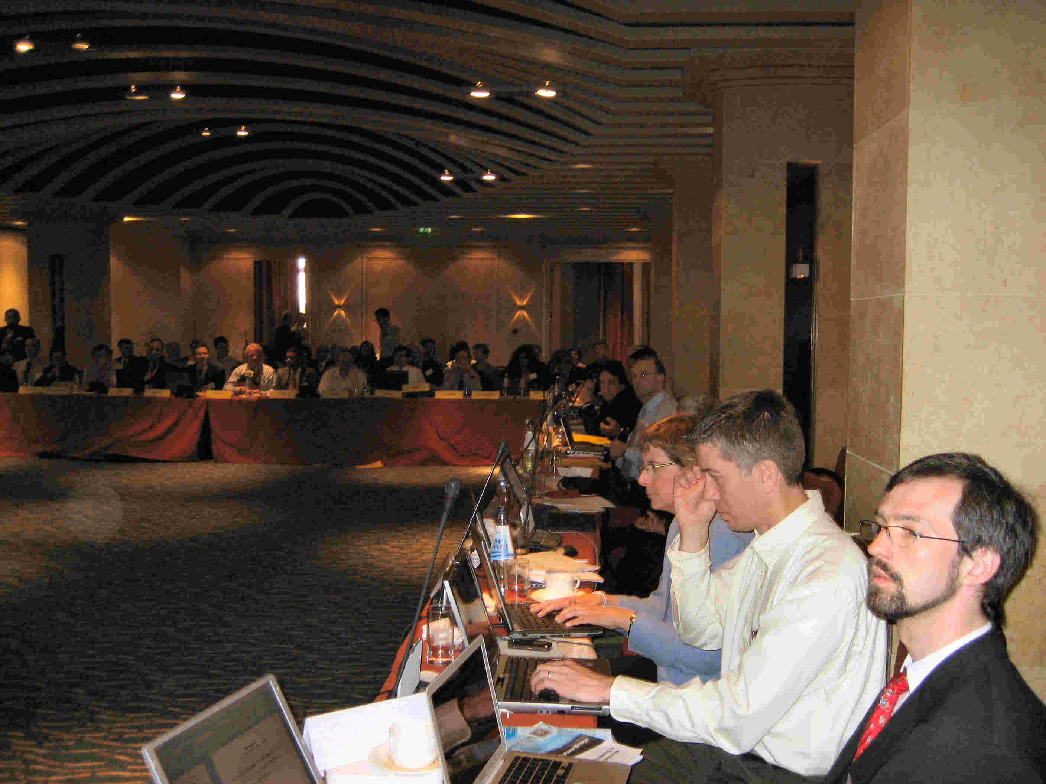
Notes:
There was the excellent Region 8 meeting that was held in Malta

Slide 7
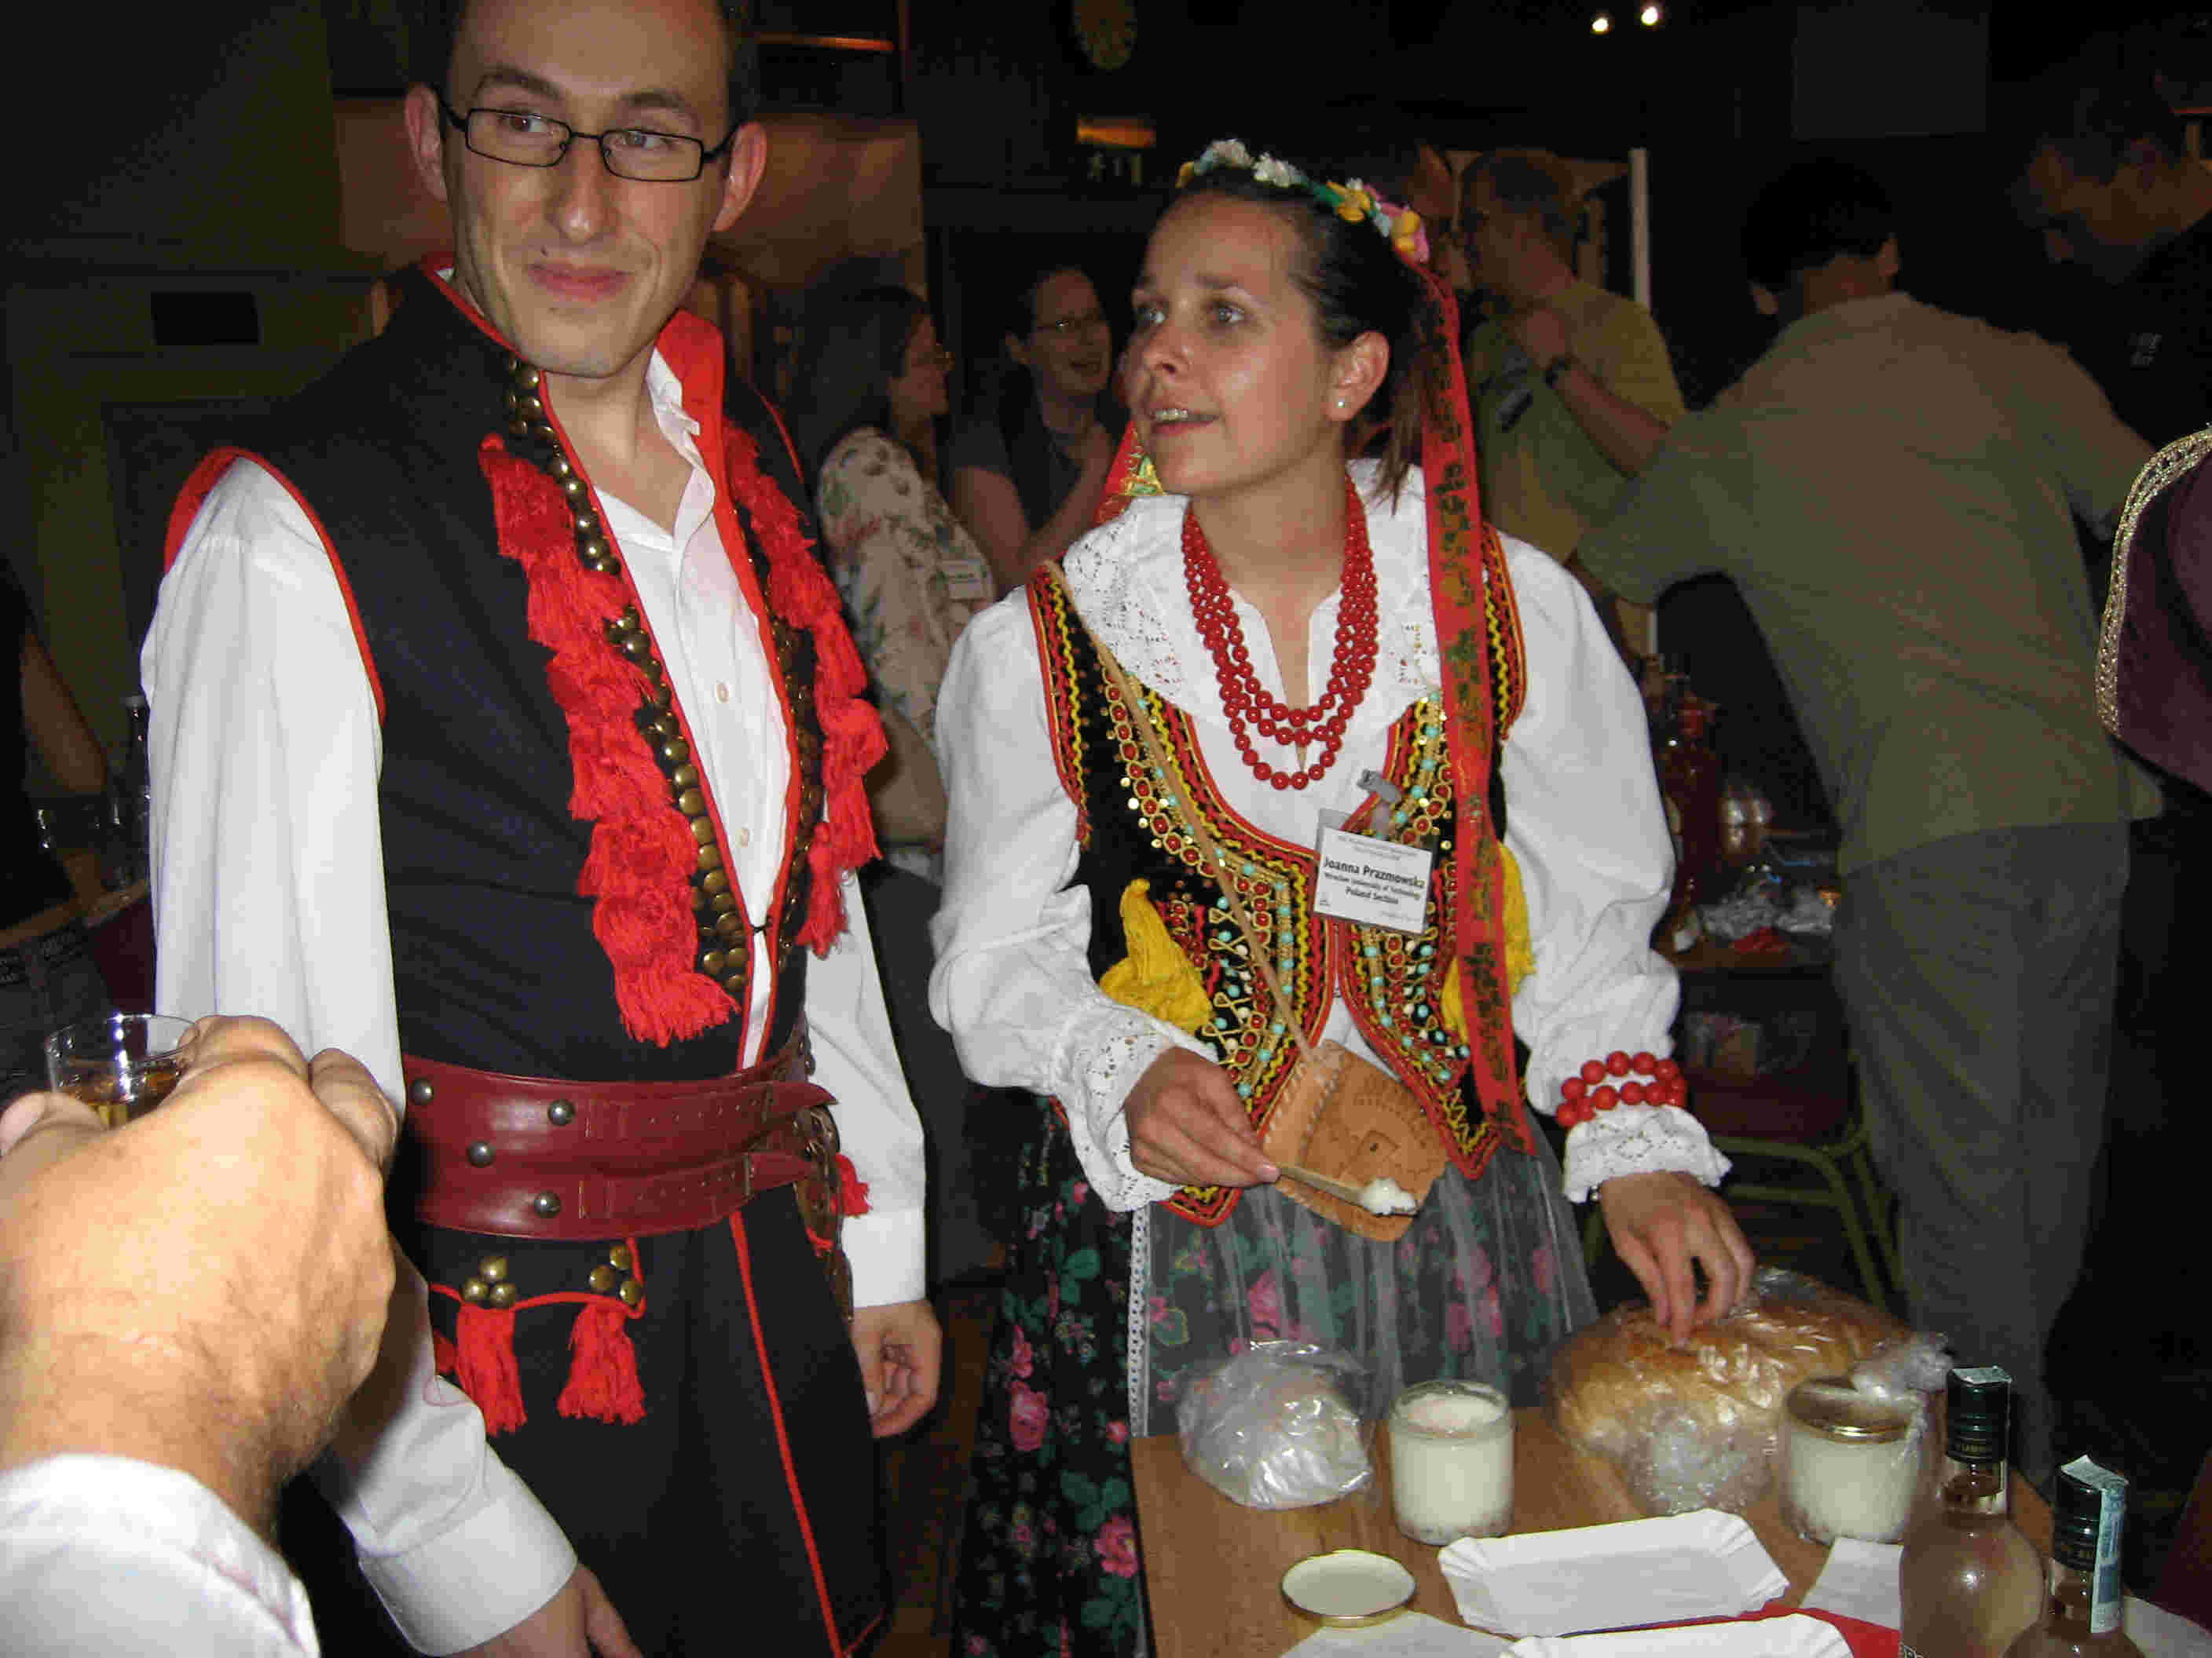
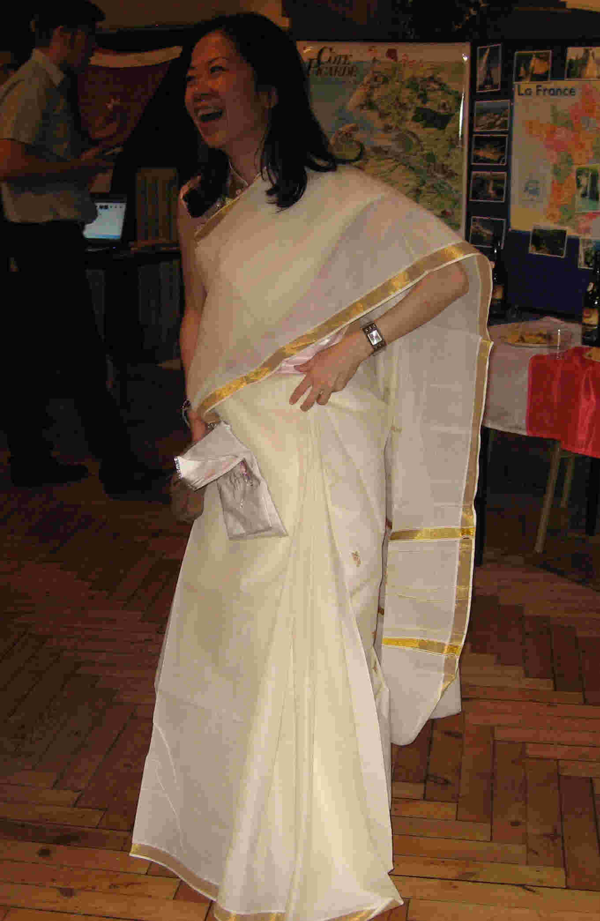
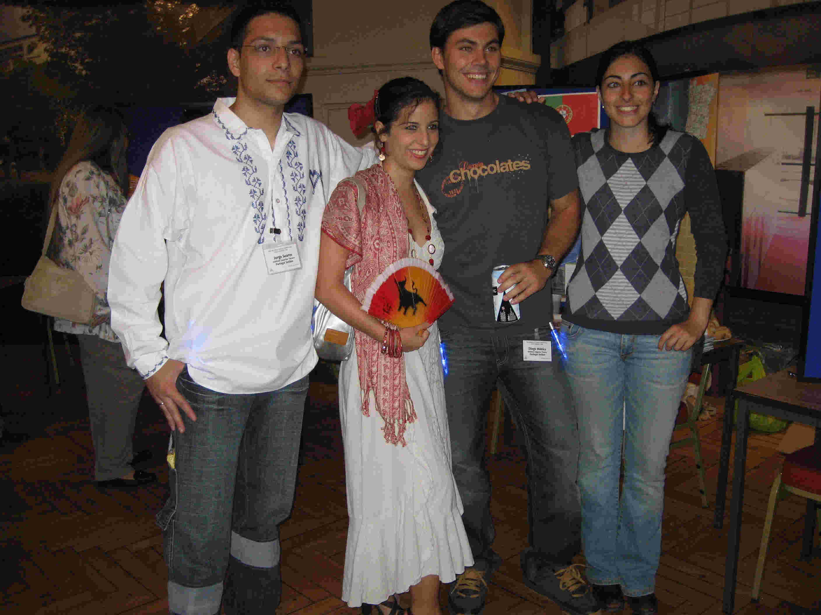
Notes:
In London we supported a Region 8 Student Congress.
Much good work was done,,,,and at the Social event the Students entertain their guests…each in their own traditional manner… and we celebrate the diversity of cultures that is Region 8

Slide 8
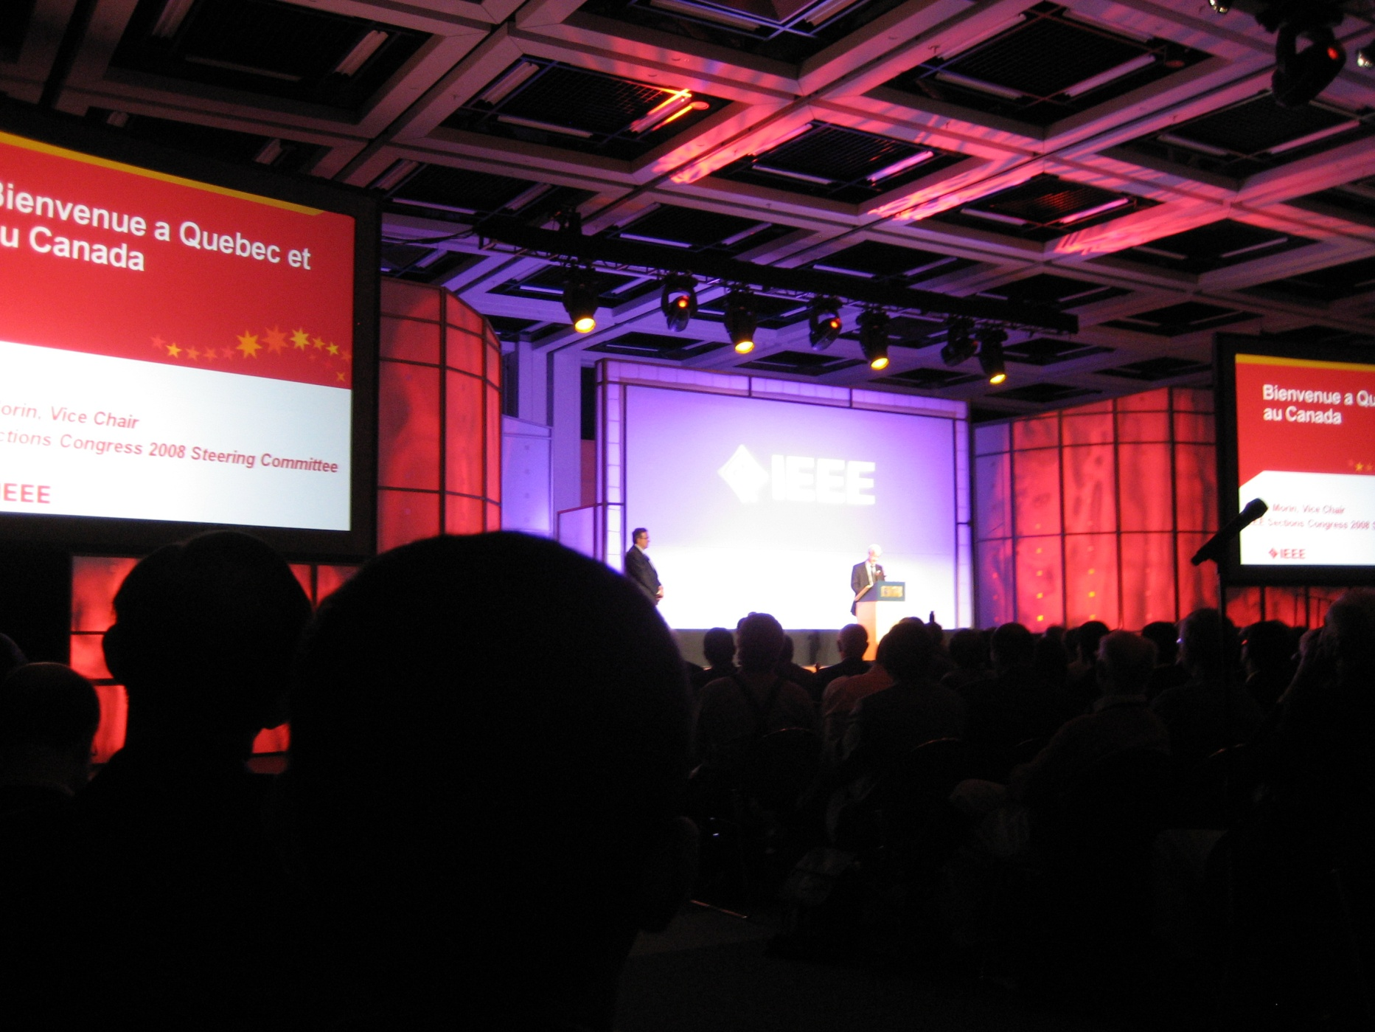
Notes:
All of us (I think most of us present here) went to Québec City for IEEE Sections’ Congress.

Slide 9
The Cost
 | BUDGET | ACTUAL | VARIANCE
MALTA | 90,000 | 181,852 | 91,852
QUÉBEC | 226,400 | 292,133 | 65,733
STUDENT CONGRESS | 55,000 | 69,603 | 14,603
CONFERENCES | 6,000 | 22,000 | 16,000
STUDENT PAPER CONTEST | 10,000 | 21,630 | 11,630
Notes:
It is our belief that all of these events were of an essential value to Region 8 and to its future
However, there was of course a cost to this which for 2008 has high.
We did make serious consideration to removing the Student event, but the overwhelming feeling was that this would be damaging to the Region.
(I would just say that the students succeeded in matching us with a further $32,000 in addition to the figures shown……which removed the financial risk element)
Since these figures essentially account for our deficit of last year I have given explanation to the Committee of the reason for each.
I thank Jean-Gabriel for his independent review of these results. I also thank Martin Bastiaans for his review of the Student matters and we agree to reduce the figure that is shown,,,,,,

Slide 10
The Cost
 | BUDGET | ACTUAL | VARIANCE
MALTA | 90,000 | 181,852 | 91,852
QUÉBEC | 226,400 | 292,133 | 65,733
STUDENT CONGRESS | 55,000 | 69,603 | 14,603
CONFERENCES | 6,000 | 22,000 | 16,000
 |  |  | 18,000
STUDENT PAPER CONTEST | 10,000 | 21,630 | 8,000
Notes:
My apology to Martin for any misrepresentation that was implied by the original figures.
Are there any questions on these particular expenditures?

Slide 11
Notes:
Let us Summarise then the results for Region 8:
Pick out main points on Income:
Actual exceeds Budget
VCF (Donations) still nor recovered from the events of 2007
Bank interest decreasing because of reduced cash held & reduced interest rates
Pick out main points on Expenditures:
The major expenditures have been discussed
In general lower expenditure from Vice Chair budgets to support Sections’ Congress, except for Students with Student Branch Congress and the Paper Contest
In 2008 we made advanced payments for some future Committee Meetings
The Profit and Loss result shows the deficit owing to the Cost budget and to the Investment Account.

Slide 12
Investments
The Long Term Investment Fund
Notes:
Region 8 has, compared with the other Regions of IEEE, in the past had a significant interest in the IEEE managed Long Term Investment Fund.
The events in the global financial market since last September have been unprecedented. Stock and Credit Market conditions continue to be extremely volatile. This turbulence is expected to continue for some time.
As a result Region 8 has experienced a significant decline in its investment interests.

Slide 13
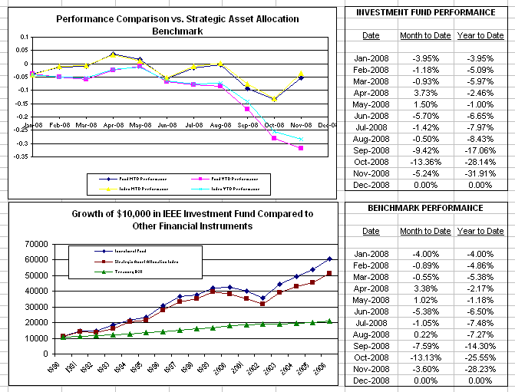
Notes:
Looking at the upper graphic:
The pink’ish line indicates the fund’s year-to-date performance. The blue’ish line indicates performance against a market index.
The black and yellow lines indicate month-to-date performance.
The data is to the right of the graphics and the presentation is in your Agenda book.
Looking at the lower graphic:
In general the performance of the IEEE Long term Investment Fund has been positive. (Some ground was lost during the 2002 to 2003 era).
$10,000 invested over 16 years would now be worth $60,000
Since the purchase price of each Share has dropped we can afford to buy more. This should give us an increased benefit when the market recovers.

Slide 14
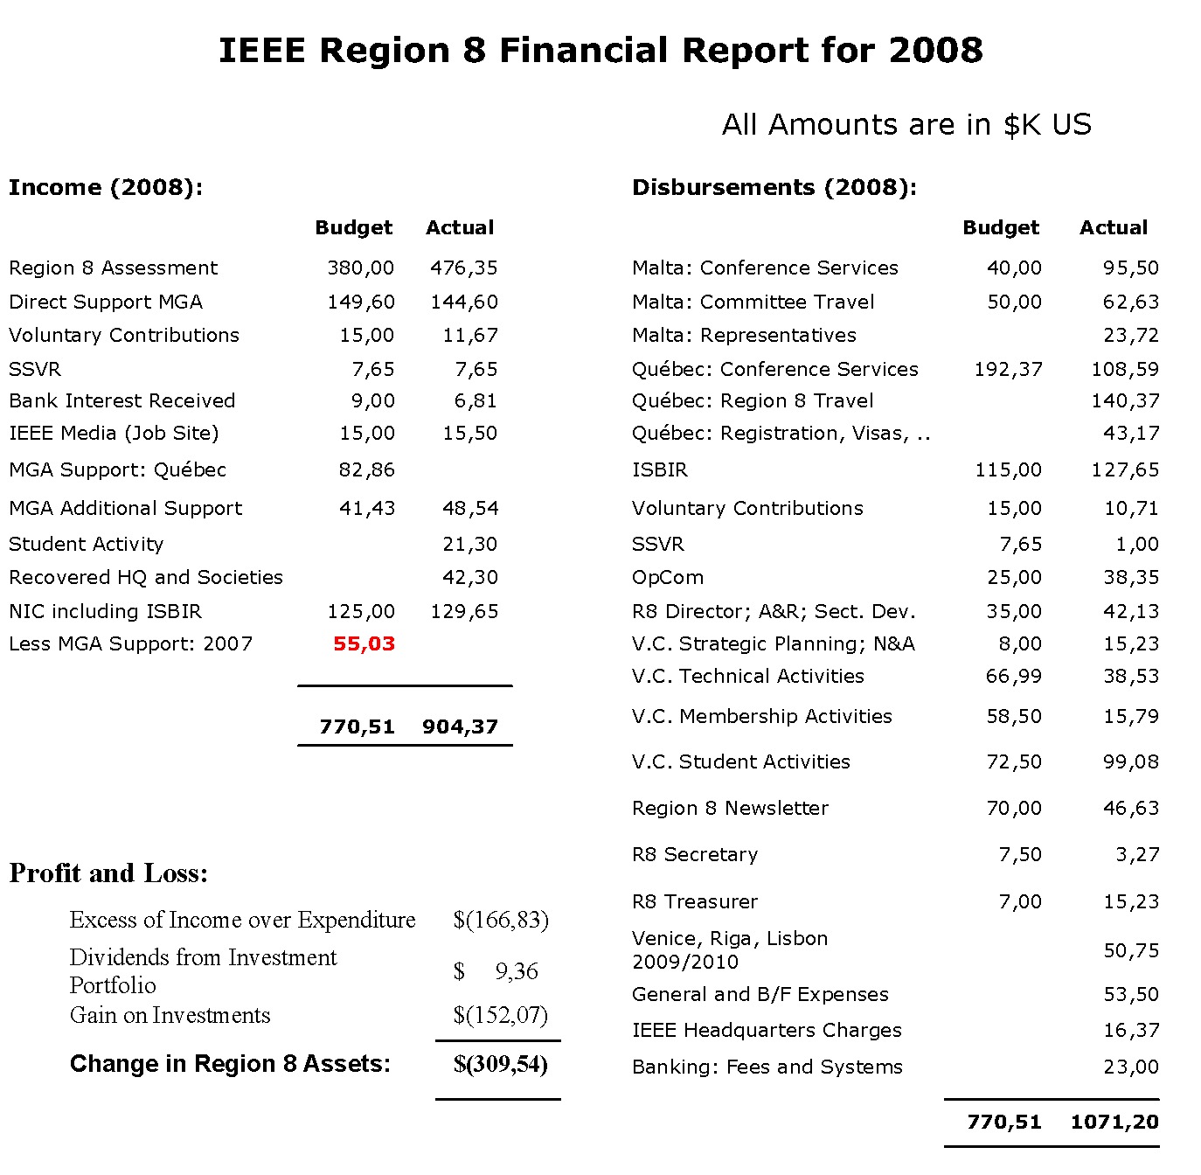
Notes:
Let us Summarise then the results for Region 8:
Pick out main points on Income:
Actual exceeds Budget
VCF (Donations) still nor recovered from the events of 2007
Bank interest decreasing because of reduced cash held & reduced interest rates
Pick out main points on Expenditures:
The major expenditures have been discussed
In general lower expenditure from Vice Chair budgets to support Sections’ Congress, except for Students with Student Branch Congress and the Paper Contest
In 2008 we made advanced payments for some future Committee Meetings
The Profit and Loss result shows the deficit owing to the Cost budget and to the Investment Account.

Slide 15
Income (2008):
 | Budget | Actual
Region 8 Assessment | 380,00 | 476,35
Direct Support MGA | 149,60 | 144,60
Voluntary Contributions | 15,00 | 11,67
SSVR | 7,65 | 7,65
Bank Interest Received | 9,00 | 6,81
IEEE Media (Job Site) | 15,00 | 15,50
MGA Support: Québec | 82,86
MGA Additional Support | 41,43 | 48,54
Student Activity |  | 21,30
Recovered HQ and Societies |  | 42,30
NIC including ISBIR | 125,00 | 129,65
Less MGA Support: 2007 | 55,03
 | 770,51 | 904,37
Notes:
Let us Summarise then the results for Region 8:
Pick out main points on Income:
Actual exceeds Budget
VCF (Donations) still nor recovered from the events of 2007
Bank interest decreasing because of reduced cash held & reduced interest rates
Pick out main points on Expenditures:
The major expenditures have been discussed
In general lower expenditure from Vice Chair budgets to support Sections’ Congress, except for Students with Student Branch Congress and the Paper Contest
In 2008 we made advanced payments for some future Committee Meetings
The Profit and Loss result shows the deficit owing to the Cost budget and to the Investment Account.

Slide 16
R8 Director; A&R; Sect. Dev. | 35,00 | 42,13
V.C. Strategic Planning; N&A | 8,00 | 15,23
V.C. Technical Activities | 66,99 | 38,53
V.C. Membership Activities | 58,50 | 15,79
V.C. Student Activities | 72,50 | 99,08
Region 8 Newsletter | 70,00 | 46,63
R8 Secretary | 7,50 | 3,27
R8 Treasurer | 7,00 | 15,23
Venice, Riga, Lisbon 2009/2010 |  | 50,75
General and B/F Expenses |  | 53,50
IEEE Headquarters Charges |  | 16,37
Banking: Fees and Systems |  | 23,00
 | 770,51 | 1071,20
Disbursements (2008):
 | Budget | Actual
Malta: Conference Services | 40,00 | 95,50
Malta: Committee Travel | 50,00 | 62,63
Malta: Representatives |  | 23,72
Québec: Conference Services | 192,37 | 108,59
Québec: Region 8 Travel |  | 140,37
Québec: Registration, Visas, .. |  | 43,17
ISBIR | 115,00 | 127,65
Voluntary Contributions | 15,00 | 10,71
SSVR | 7,65 | 1,00
OpCom | 25,00 | 38,35
R8 Director; A&R; Sect. Dev. | 35,00 | 42,13
Notes:
Let us Summarise then the results for Region 8:
Pick out main points on Income:
Actual exceeds Budget
VCF (Donations) still nor recovered from the events of 2007
Bank interest decreasing because of reduced cash held & reduced interest rates
Pick out main points on Expenditures:
The major expenditures have been discussed
In general lower expenditure from Vice Chair budgets to support Sections’ Congress, except for Students with Student Branch Congress and the Paper Contest
In 2008 we made advanced payments for some future Committee Meetings
The Profit and Loss result shows the deficit owing to the Cost budget and to the Investment Account.

Slide 17
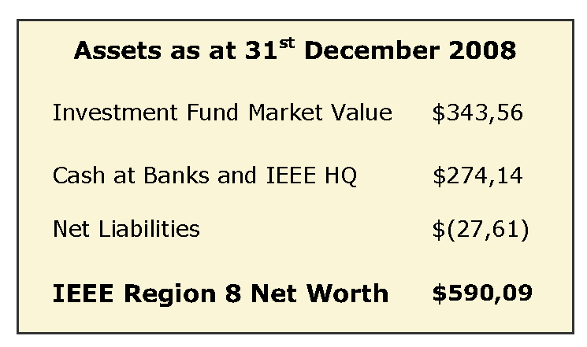
Notes:
As at the end of the last year (after a revaluation of the currencies held) Region 8 had a Net Worth of just under $600,000
Are there any question?

Slide 18
The Future
We should seek to rebuild our Assets:
Cash Flow
2010 – We Should Consider a Region 8 Student Branch Congress
2011 – IEEE Sections’ Congress
More Projects from Section Chairs
Notes:
Why is Cash flow important to Region 8?

Slide 19
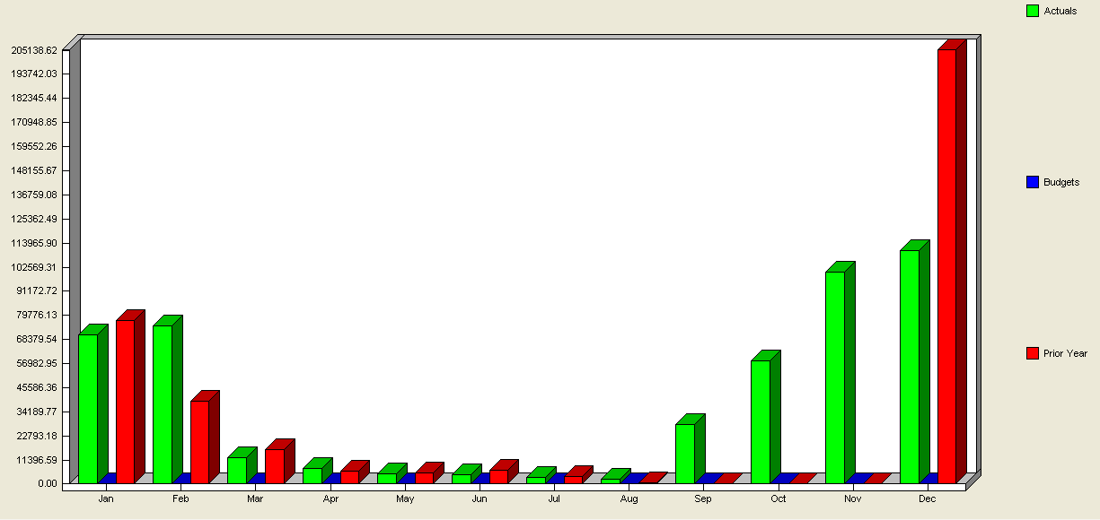
Assessment Income: 2007 and 2008
Notes:
To a large extent Region 8 is dependent on Assessment Income.
This is income that is “rebated” to the Region as members join and existing members renew. You can see that it follows the annual renewal pattern quite well.
Green is the pattern for 2008 and Red is the pattern for 2007.
Note:
There is little income during the middle of the year, which is a concern if two major events occur August to September (SBC and Sections’ Congress)
And
In addition in 2007 there was also no income September to November. A consequence of IEEE implementing a new BMS computer system.
Both of these are classic examples why an organisation needs some contingency funds in the bank.

Slide 20
The Future
We should seek to rebuild our Assets:
Cash Flow
2010 – We Should Consider a Region 8 Student Branch Congress
2011 – IEEE Sections’ Congress
More Projects from Section Chairs
Notes:
We need to improve our position for important events in 2010 and in 2011
And
We would like to be in a position to fund Projects that are in the strategic interest of Region 8 direction and coming from the Section Chairs
So, where do we go?

Slide 21
A Budget for 2009
The Issues:
Regional Development
vs
Cut Costs
Notes:
My personal conviction is that a priority is to keep membership growth positive
For an organisation like IEEE there are many reasons why Membership can be lost.
Once it goes into reverse (people walk away) it can be difficult to turnaround.
Needs money.
Take the Accountant’s Approach
Reduce activity and spend to a minimum level and leave the money in a bank.
We need to find the correct balance.
.

Slide 22
A Budget for 2009
Proposal:
Reduce Budget
and
Change Emphasis
Concern:
Membership Retention
Notes:
Our proposal is to reduce the budget for 2009, but to start to change the emphasis.
The main Threat.
The consequence of the global financial crises on people’s personal position and their continuing interest in IEEE.
However, a strong attribute of Region 8 is its diversity and so perhaps we can be optimistic.

Slide 23
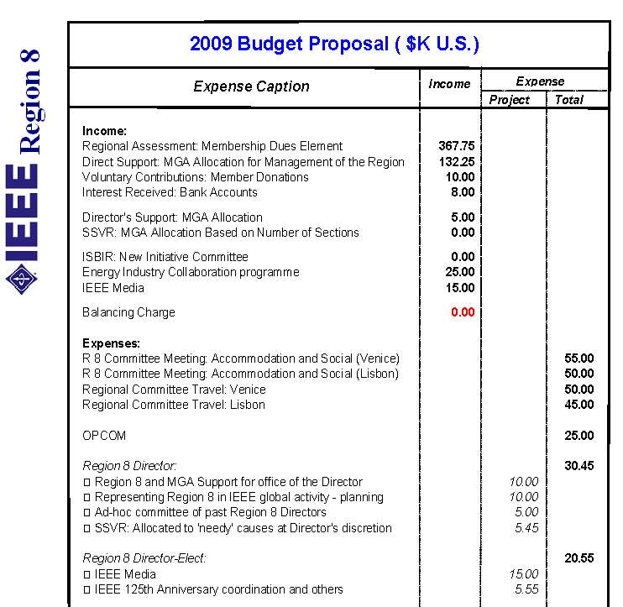
Budget 2002: $607:90K
Budget 2005: $688:85K
Budget 2007: $632:00K
Budget 2008: $770,51K
Budget 2009: $563,00K
Notes:
The proposal is to set a budget for 2009 of $563:000
The slide shows the income that has been allocated – a copy is in your Agenda book
There is no income included for SSVR pending decision by MGA
An amount for ISBIR is not included as there is discussion with MGA and a future transition path for ISBIR is in discussion
There is caution shown on the Assessment Income and the further increase of the VCF fund
I have now a good agreement for our meeting in Lisbon in October

Slide 24
Budget 2002: $607:90K
Budget 2005: $688:85K
Budget 2007: $632:00K
Budget 2008: $770,51K
Budget 2009: $563,00K
Notes:
The proposal is to set a budget for 2009 of $563:000
The slide shows the income that has been allocated – a copy is in your Agenda book
There is no income included for SSVR pending decision by MGA
An amount for ISBIR is not included as there is discussion with MGA and a future transition path for ISBIR is in discussion
There is caution shown on the Assessment Income and the further increase of the VCF fund
I have now a good agreement for our meeting in Lisbon in October

Slide 25
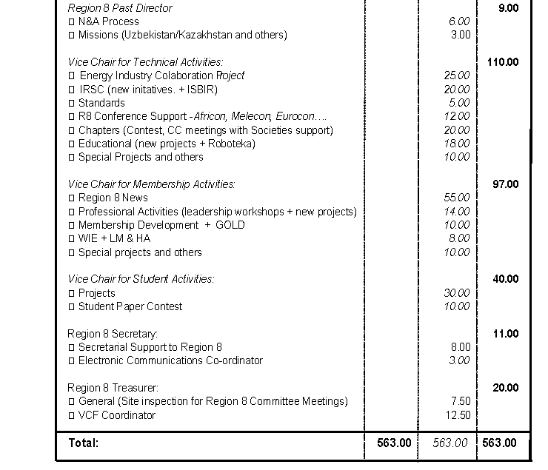
Emphasis towards Technical Activity.
Small reduction in Membership Activity.
Student Activity will be large in 2010.
Notes:
The expenses side shows an emphasis this year towards the Technical Activity with good continuing support for Membership Activity.
The students miss out a little this year, but have some scope for their meetings and for special projects. It is hoped that some proposals will be forthcoming for a Student Branch Congress next year.
I have reached the end of the presentation, but will be happy to answer any questions.

Slide 26
Emphasis towards Technical Activity.
Small reduction in Membership Activity.
Student Activity will be large in 2010.
Notes:
The expenses side shows an emphasis this year towards the Technical Activity with good continuing support for Membership Activity.
The students miss out a little this year, but have some scope for their meetings and for special projects. It is hoped that some proposals will be forthcoming for a Student Branch Congress next year.
I have reached the end of the presentation, but will be happy to answer any questions.

Slide 27
Thank You

Slide 28
Notes:
So, if we return to our graphic on funding ….

