Slide 1
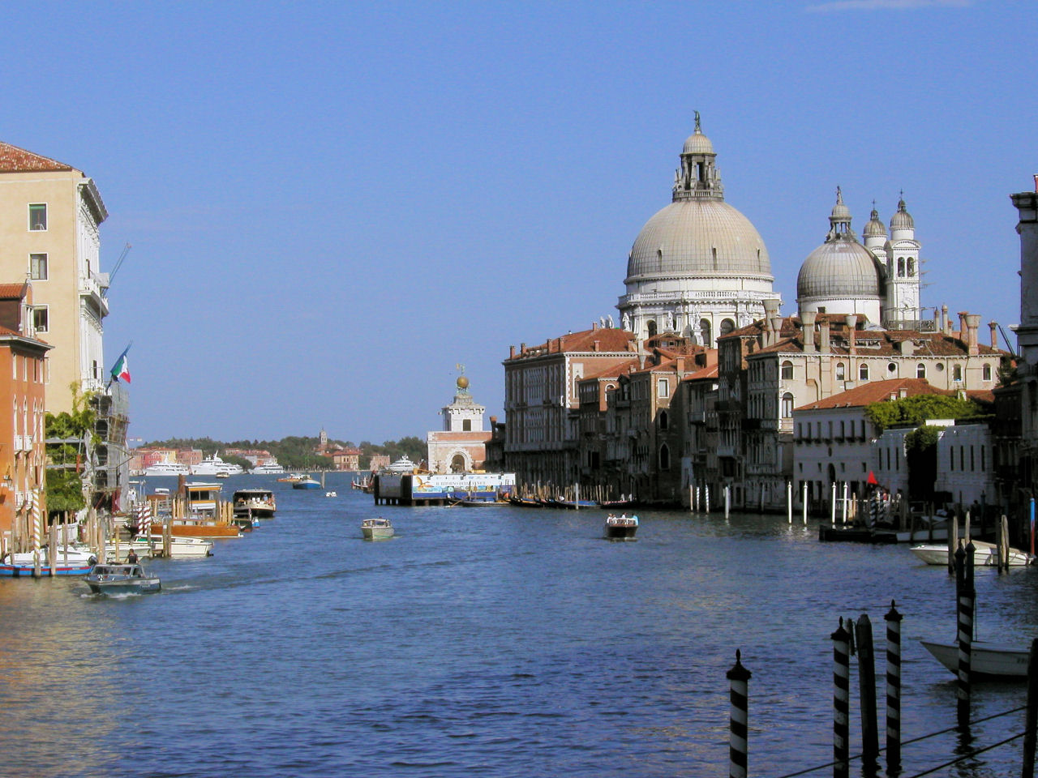
Some Reflections
Lew Terman
IEEE Past President
IEEE Region 8 Meeting
Venice, Italy
26 April, 2009

Slide 2
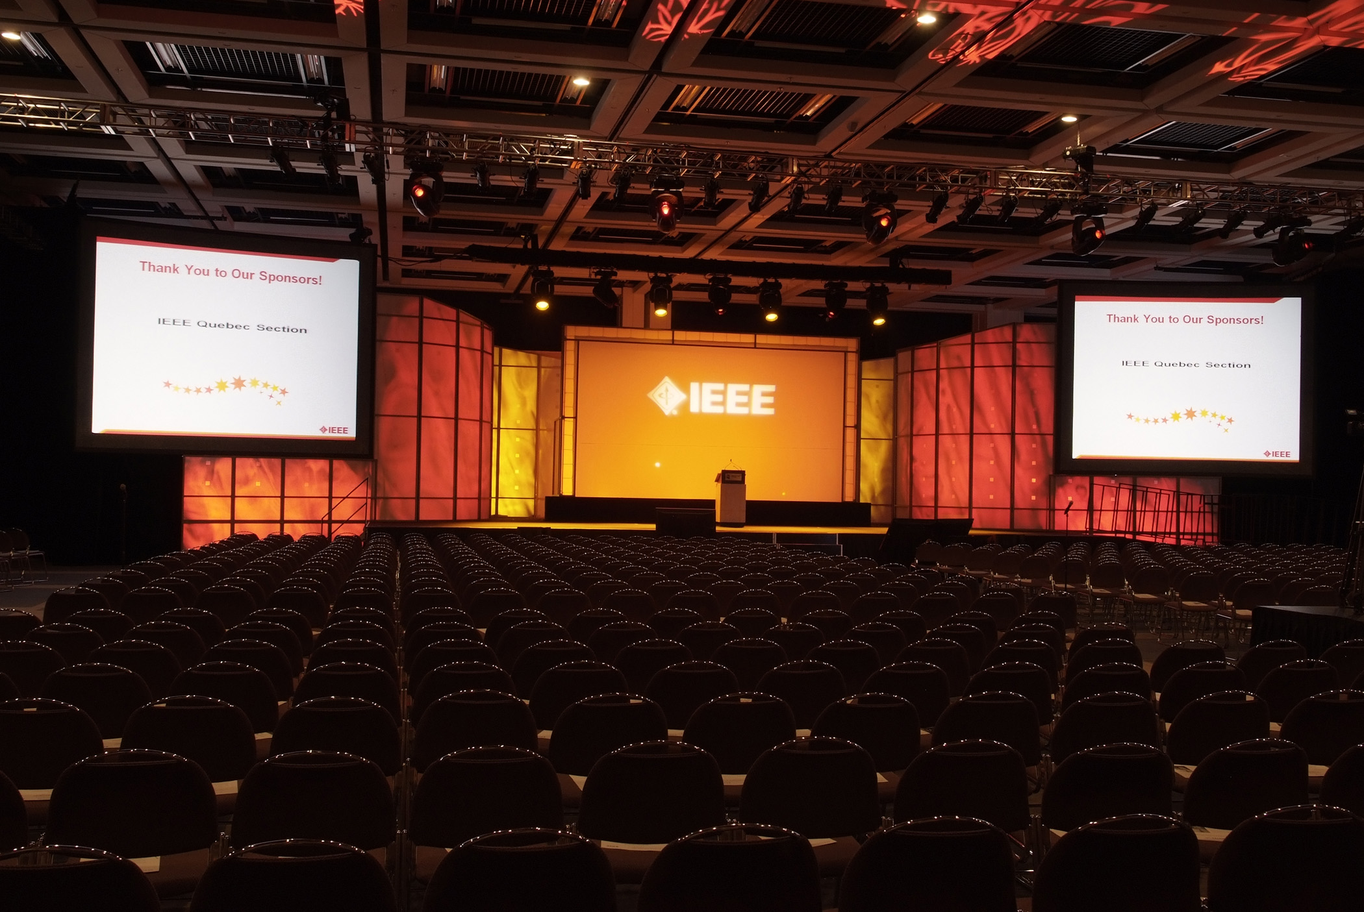

Slide 3
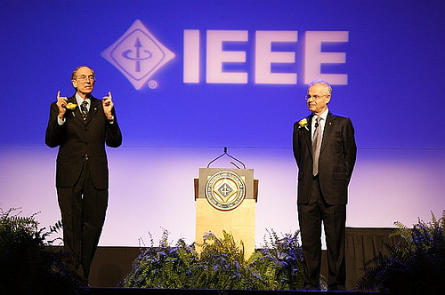

Slide 4
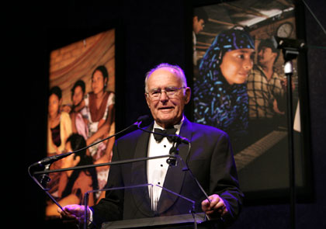
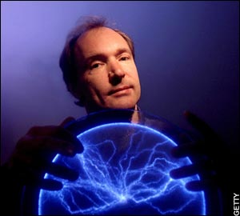
Gordon Moore
IEEE Medal of Honor
Tim Berners-Lee
IEEE/RSE Wolfson
James Clerk Maxwell Award

Slide 5
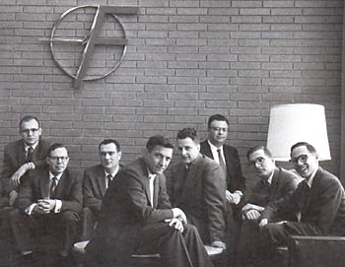
The Fairchild Eight (a.ka. the Shockley Eight) at Fairchild Semiconductor in 1959. From left: Gordon Moore, Sheldon Roberts, Eugene Kleiner, Bob Noyce, Victor Grinich, Julius Blank, Jean Hoerni, and Jay Last.

Slide 6
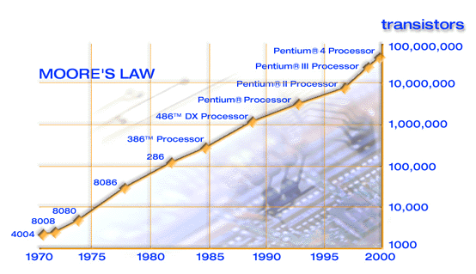

Slide 7
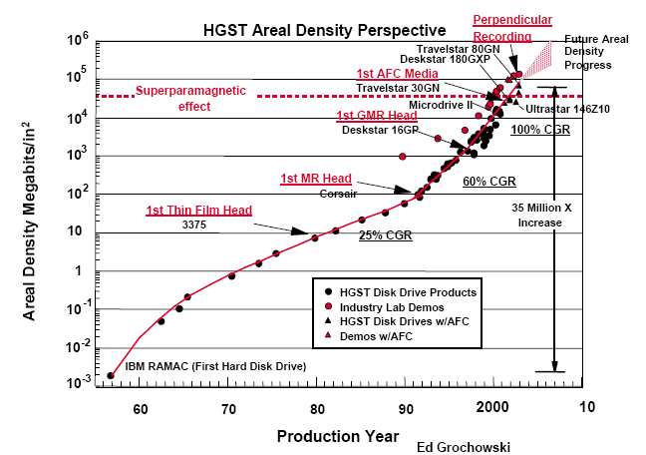
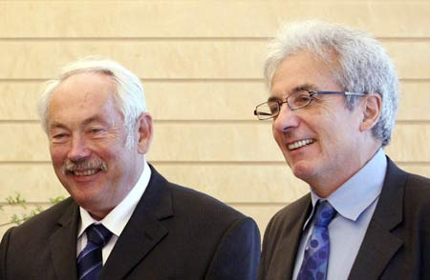
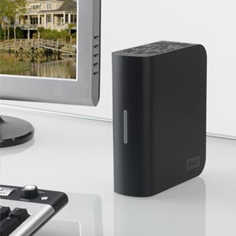
2007 Nobel Prize in Physics for “the discovery of Giant Magnetorestance”
Peter Grunberg and Albert Fert
1 TB Storage for < 100 Euros

Slide 8
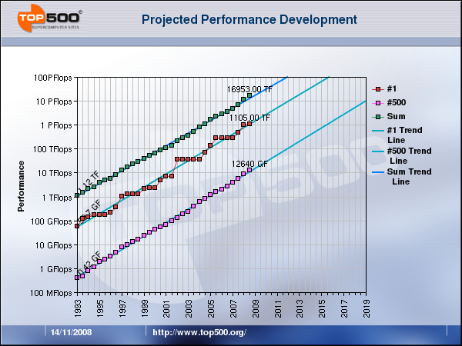
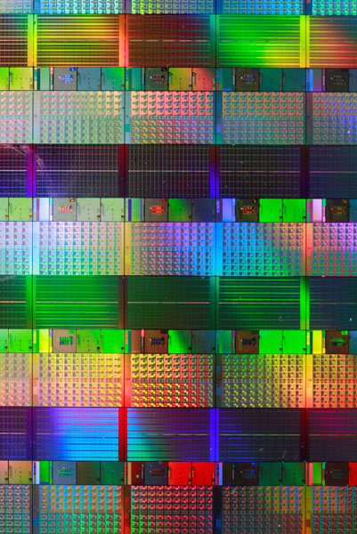

Intel Teraflops
Chip
Jack Dongarra

Slide 9
IEEE Humanitarian Activities
Humanitarian Technology Network (IEEE Foundation)
Humanitarian Technology Fund (IEEE Foundation)
Humanitarian Technology Challenge (with the UN Foundation)
Grameen Foundation project with IEEE Foundation (India)
Humanitarian Conference (India)
Brahamam Research Forum (India)
Tsunami Relief Communication Effort (India)
Information System for Health and Human Services – ISHHS - (India)
Global Earth Observation System of Systems - GEOSS (International)
IEEE Committee on Earth Observation
IEEE Lethal Arc Flash Standard Development
IEEE - South Africa MOU “Advisor to Nations”
IEEE Clean Water Seed Grant
IEEE Presidents’ Change the World Competition
IEEE Sustainability AHC
IEEE Humanitarian AHC
2008 GOLD Humanitarian Workshop
IEEE members humanitarian work in Panama
Megacities (TAB)
125th Anniversary AHC
Public Visibility AHC
India AHC

Slide 10
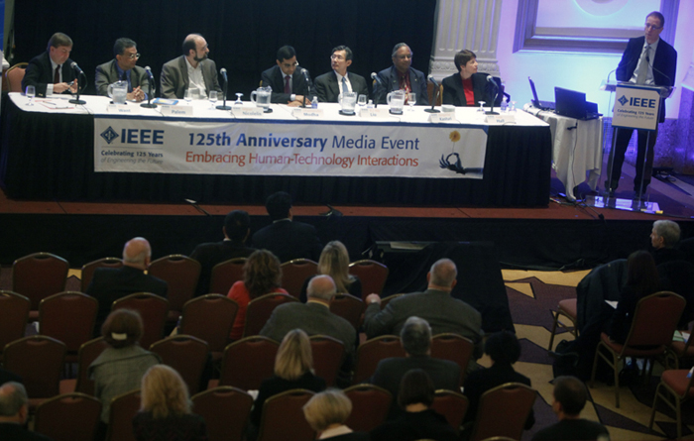

Slide 11
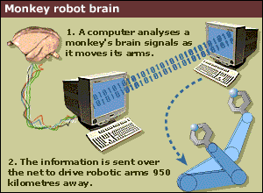
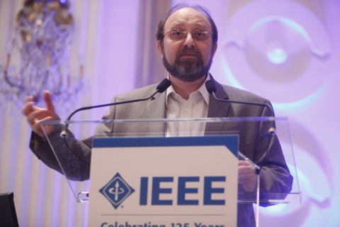
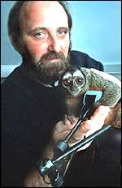
Direct Human-Robot Communication
Miguel Nicolelis

Slide 12
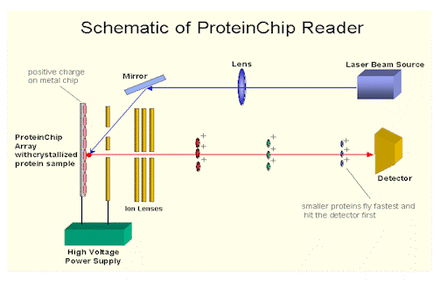
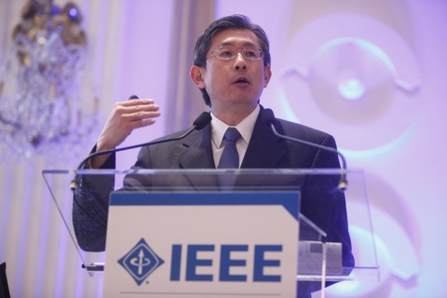

Early Cancer Detection
This is a paradigm shift in cancer diagnosis from completely biological process to the engineering digital world. We are seeing the dawn of digital revolution in cancer diagnosis at genomic/proteomic levels by using digital signal processing.
Now through the use of ensemble dependence model (EDM), we can classify cancer highly accurately. Moreover, we may be able to predict whether a sample is in transition from normal to cancer stage.
The end goal is that one day one can go to routine annual check with a single blood draw, a doctor can advise his/her patients to watch out, for example, liver or breast cancer, closely since it is no longer normal, nor in cancer stage yet, but in transition to the cancer stage.
Roy Liu

Slide 13
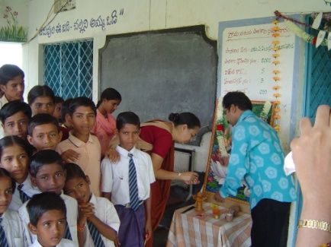

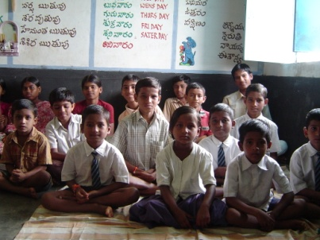
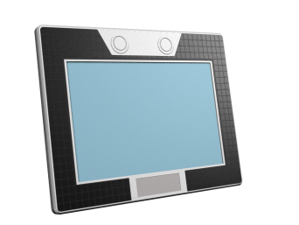
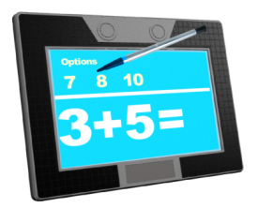



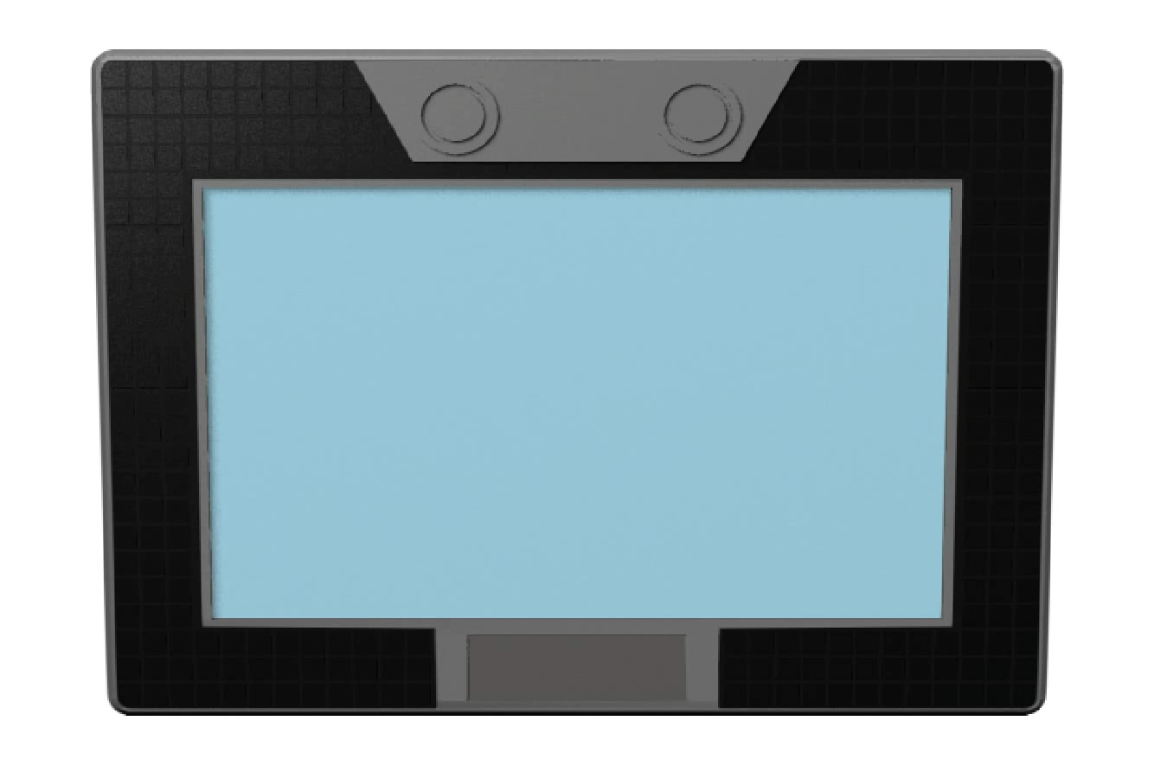
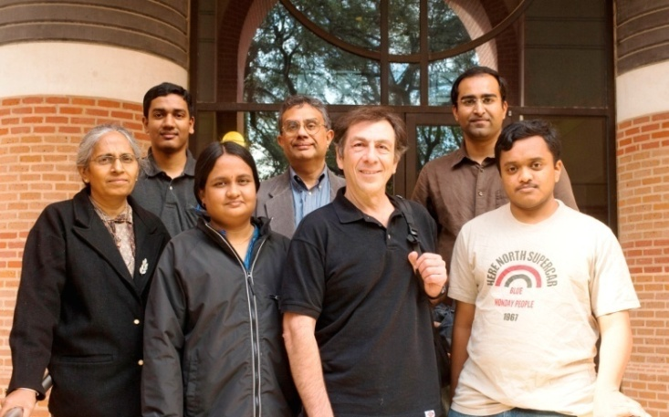

Delivering Sustainable Literacy in India
8
Caltech
Technology
Pedagogy and content
ViDAL, Hyderabad
VISEN Center Rice University
Integration
cITe, IIIT-Hyderabad,
India
ViDAL was setup in 2004 to promote development of rural communities in India through information and communication technologies. It launched an award-winning project called “Computers on Wheels’ for people-centered development.
ISNE, Nanyang Technological University, Singapore
The I-SLATE
Renewable electric source (solar)
Energy sustainable
Ultra low cost
Economically sustainable
No need for teachers
Literacy sustainable
Notes:
13

Slide 14
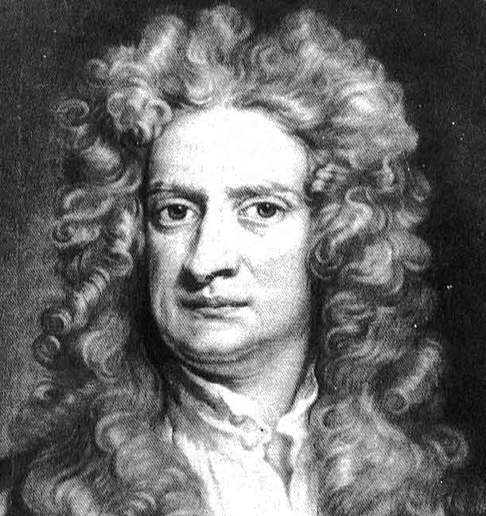
Sir Isaac Newton
“If I can see so far, it is because I stand on the shoulders of giants”

Slide 15
My deepest thanks to all of you for your dedication, energy, and enthusiasm for IEEE…..
You are invaluable to the success of the organization!

Slide 16
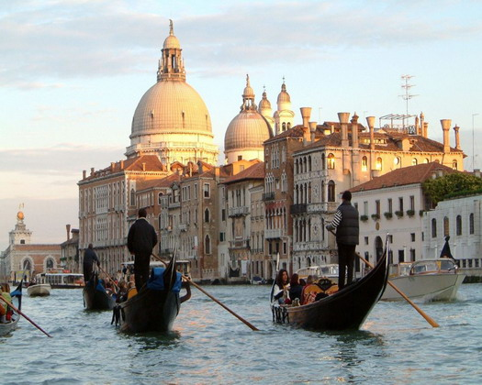

IEEE-HKN Merger
Lew Terman
2008 IEEE President
26 April, 2009
Venice, Italy
Notes:
16

Slide 17
What is Eta Kappa Nu (HKN)?
Founded in 1904
Dedicated to encouraging and recognizing excellence in electrical and computer engineering
  students, alumni, and other professionals who have demonstrated exceptional academic and professional accomplishments
Members inducted for life, pay a one-time fee at that time
Currently, has
  approximately 150,000 members
  200 Chapters
  Geographically in the US
  Scope limited to electrical and computer engineering
Notes:
17

Slide 18
Principal Activities of HKN
Induct and recognize excellent students
Provide service to the community through the 200 student chapters
Recognize excellence in EE&CE through awards for
  Eminent Members
  Students
  Young Professionals
  Young Faculty
  Technical contributors
Publish The Bridge, a quarterly magazine
Notes:
18

Slide 19
HKN Chapter Activities
Tutoring services
Community outreach
Fund raising for charitable purposes and awards
Engineering and Career Days
Career guidance events
Faculty and Course Evaluation
Sponsoring seminars and workshops
Social activities
Notes:
19

Slide 20
The Merger Timeline
Initially discussed at an informal gathering during the February 2006 BoD Series.
Proposal first presented to the BoD in November, 2007, and accepted by the BoD in February 2008
Further discussion in 2008, including….
  Technical scope: IEEE’s is significantly broader than HKN’s
  Geography: IEEE is global, HKN is US-focused
  Overlapping chapters at some academic institutions
  HKN finances, financial impact on IEEE
Formal agreement signed (at last!) February, 2009
Notes:
20

Slide 21
Key aspects of the merger
HKN becomes part of IEEE → IEEE-HKN
  A new IEEE OU (“HKN Board of Governors”)*
  Reporting structure: HKN BoG → EAB → IEEE BoD
All pre-merger members of HKN continue to have the same rights and privileges they had before
  They receive THE BRIDGE if subscribed-to for life
  They are allowed to use the title Member IEEE-HKN
*Initially, members are the same as the current HKN BoG
Notes:
21

Slide 22
Key aspects (con’t)
All post-merger inductees into HKN become members of IEEE-HKN and members of IEEE for the year of induction
  Part of the induction fee is paid as IEEE membership fee in the first year
Continued membership of post-merger inductees in IEEE-HKN requires continued membership in IEEE
  A person who drops his/her IEEE membership can continue to declare that he/she was “inducted into IEEE-HKN”
Notes:
22

Slide 23
Why is a Merger with HKN good for IEEE?
Worldwide
HKN may help us identify, serve and nurture…
  Student leaders
  Young faculty – outstanding educators
  Young practitioners – working engineers
Incorporation of the HKN recognition process may address one of our main problems: the inability to retain students after graduation
Notes:
23

Slide 24
Benefits to IEEE (con’t)
A merger with HKN gives IEEE…
  Access to a long established, well-known, and venerated organization
  Instant access to a large pool of the best Electrical and Computer Engineering students in the US
  The infrastructure and methodology to expand the honor society to other Regions
  The opportunity to bring into IEEE the student segment recognized as having the best leadership potential
  The infrastructure to recognize students and young practitioners/professionals
Notes:
24

Slide 25
Gives IEEE a Student Honor Society
IEEE is not associated at present with an academic honor society
  ACM is associated with Upsilon Pi Epsilon
  Every new member of Upsilon Pi Epsilon becomes a member of ACM
A significant segment of the future leadership of the profession has been “nurtured and developed” by HKN – outside of IEEE
Notes:
25

Slide 26
What are the benefits to HKN?
A merger with IEEE gives HKN…
  Instant access to a large pool of candidates for membership outside the United States
    A transformation of the organization to a transnational organization
  Better financial stability and growth prospects
  Better infrastructure in terms of communication with members, recruiting and retention
    Including long-term savings on infrastructure and administration
Notes:
26

Slide 27
Transition Activities
Expansion of IEEE-HKN fields of interest
  to be the same as that for IEEE members
Understand the relationship between IEEE Student Branches and HKN Chapter
  activities, operations, formation, funding, awards, training…
Determine transition communication plan to IEEE SBs and HKN Chapters
27
25-Apr-09

Slide 28
Transition Activities (Cont.)
Move the current HKN Member and Chapter database into the IEEE system
Coordination of ieee.org and hkn.org websites
Redefine IEEE-HKN as an international honor society
Identify issues related to global expansion
Identify potential areas of collaboration and growth of IEEE-HKN
28
25-Apr-09

Slide 29
Transition planning is expected to be completed by YE09

