Slide 1
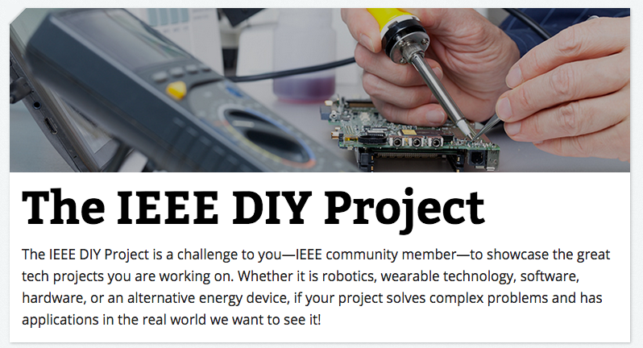
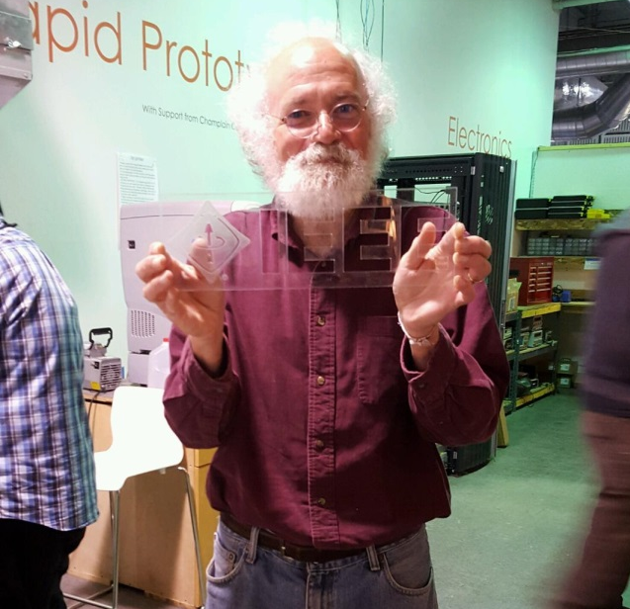

IEEE DIY Project
Have a cool tech project you want to share with the world? Submit what you are building to the IEEE DIY Project!
The IEEE DIY Project will be hosted online from 16 September to 7 December and is open to individuals 18 years or older.
A video series featuring IEEE and IBM Fellow John Cohn will review the top submissions each month
Prizes for top 5 submissions – Grand Prize = $500 Gift Card
All are invited to participate online at https://transmitter.ieee.org/diy/
Notes:
The grand prize winner will receive $500, $250 for second place, $100 for third and $50 each for the fourth and fifth place contestants.

